Slide 1

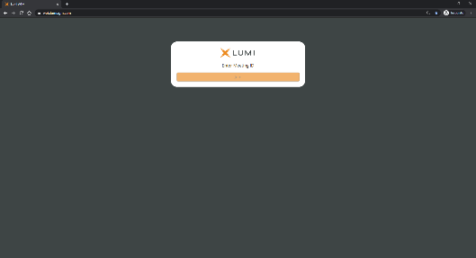




Meeting of the Unsecured Creditors of Norwegian Air International Limited
Meeting ID: 199-353-651
Meeting Access
Creditors can participate in the Meeting electronically, should they wish to do so. This can be done by accessing the meeting website, https://web.lumiagm.com
This can be accessed online using most well-known internet browsers such as Internet Explorer (Not compatible with versions 10 and below), Chrome, Firefox and Safari on a PC, laptop or internet-enabled device such as a tablet or smartphone.
On accessing the meeting website, you will be asked to enter a Meeting ID which is;
199-353-651
You will then be prompted to enter your unique
Login ID
PIN
These can be found within your invitation. Access to the meeting will be available from 7.15 a.m. (Irish time) / 8.15 a.m. (Norwegian time) on 19 March 2021. You will be able to appoint a proxy until 16.00 (Irish time) / 17.00 (Norwegian time) on 17 March 2021. The meeting will formally begin at 8.15 a.m. (Irish time) / 9.15 a.m. (Norwegian time) on 19 March 2021 and you will be able to use the same credentials to log back into the Lumi platform to participate in the meeting.
Broadcast
The meeting will be broadcast in audio format. Once logged in, and at the commencement of the meeting, you will be able to listen and watch the proceeding of the meeting on your device.
Voting
Once the Chair has formally opened the meeting, they will explain the voting procedure. Once voting has opened, the polling icon will appear on the navigation bar. From here, the resolutions and voting choices will be displayed.
Select the option that corresponds with how you wish to vote. Once you have selected your choice, the option will change colour and a confirmation message will appear to indicate your vote has been cast and received – There is no submit button. If you make a mistake or wish to change your vote, simply select the correct choice, if you wish to “cancel” your vote, select the “cancel” button. You will be able to do this at any time whilst the poll remains open and before the Chair announces its closure.
Questions
Shareholders attending electronically may ask questions by typing and submitting their question in writing – Select the messaging icon from within the navigation bar and type your question at the bottom of the screen. To submit your question, click the send button to the right of the text box.

Slide 2
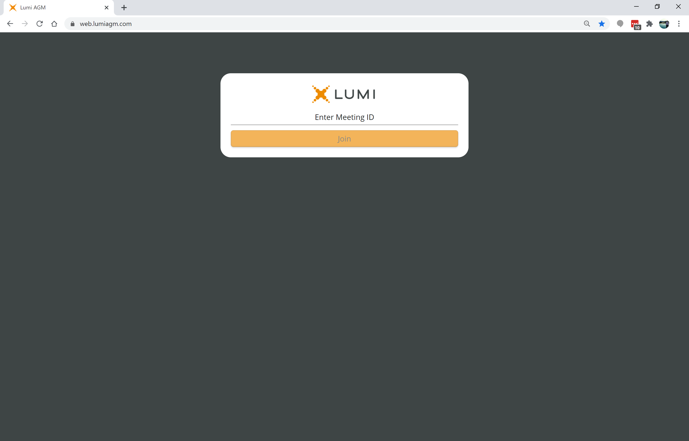
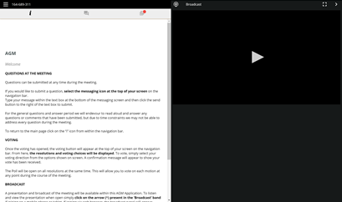

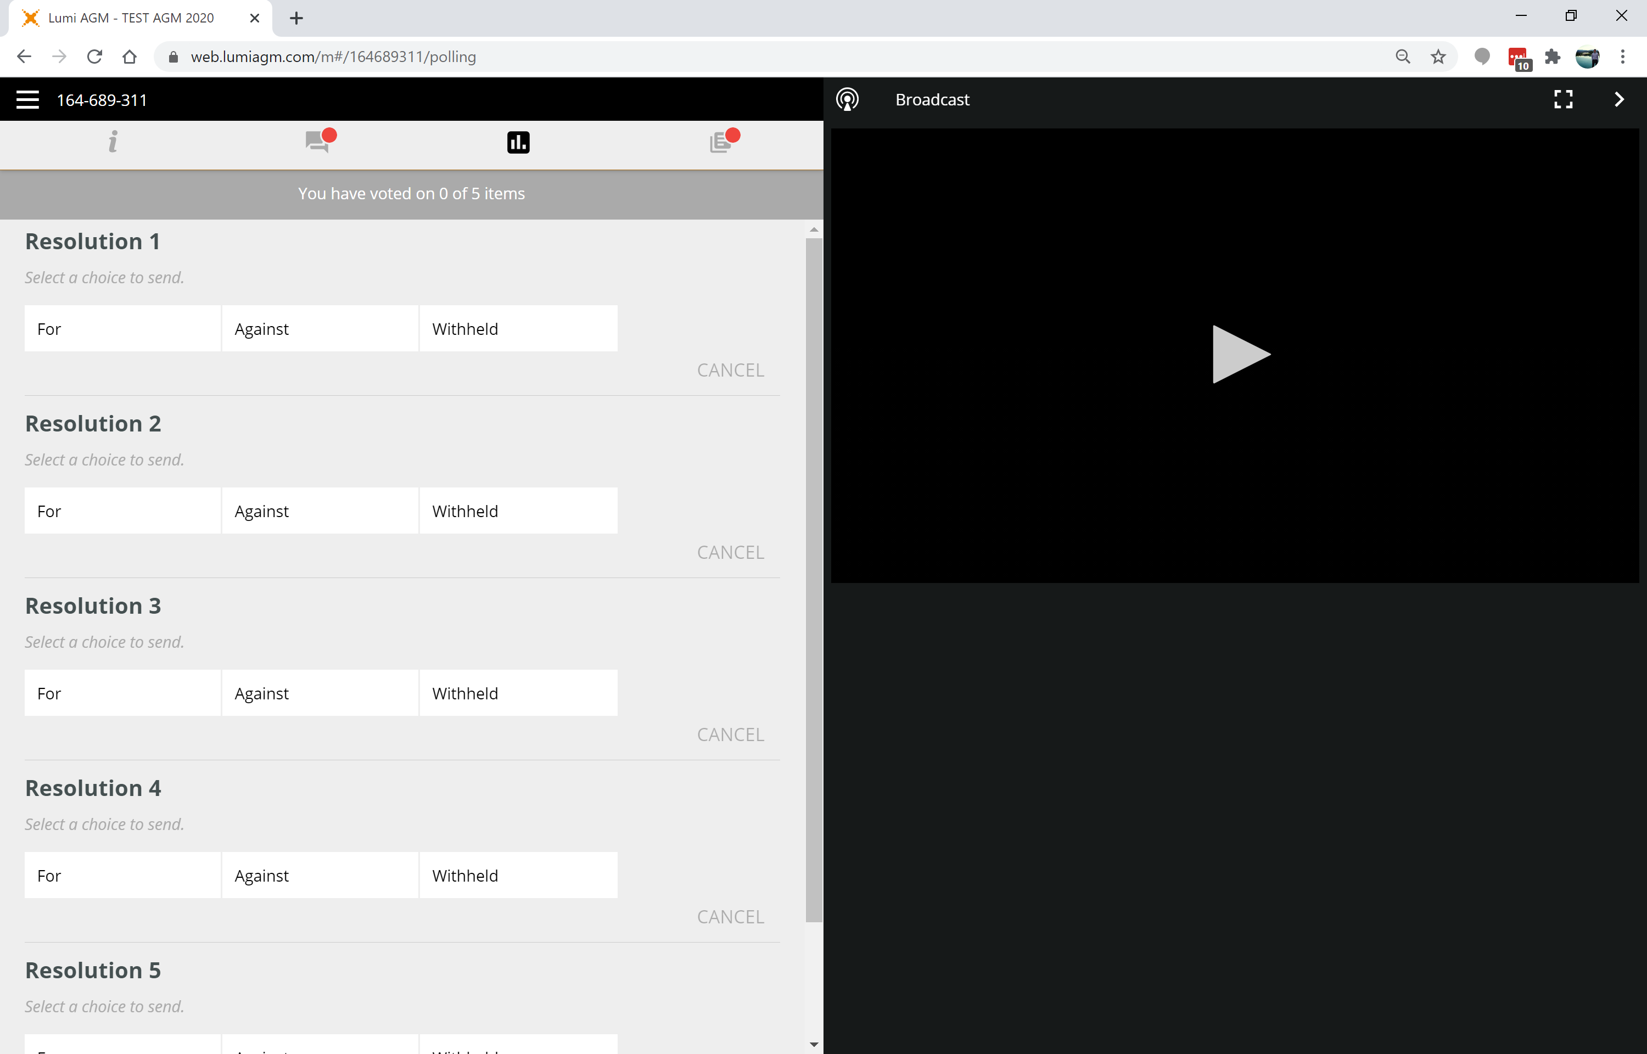
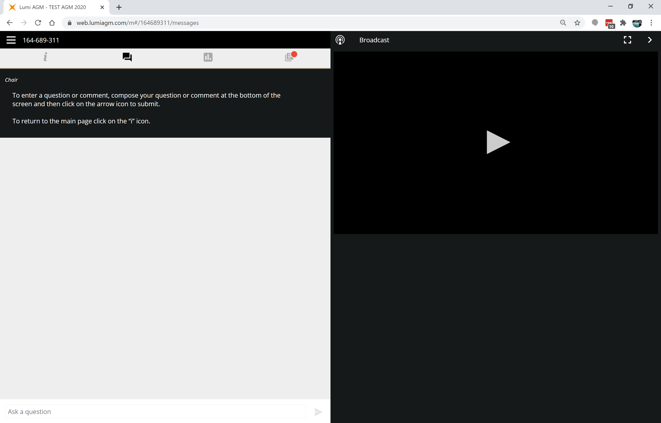
Requirements
An active internet connection is required at all times in order to allow you to cast your vote when the poll opens, submit questions and listen to the audiocast. It is the user’s responsibility to ensure you remain connected for the duration of the meeting.

